Slide 1





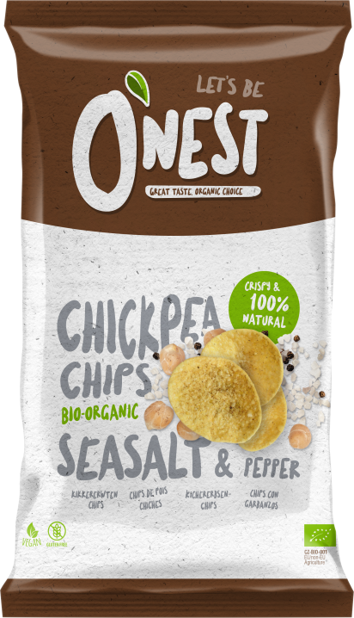
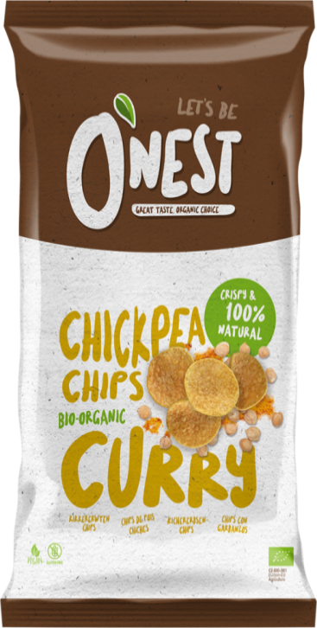


ON1224 O’nest chips
Hummus salt&pepper
10x75gr
ON914 O’nest chips
Hummus curry
10x75gr
ON1178 O’nest chips
Hummus salt&pepper
12x40gr

Slide 2
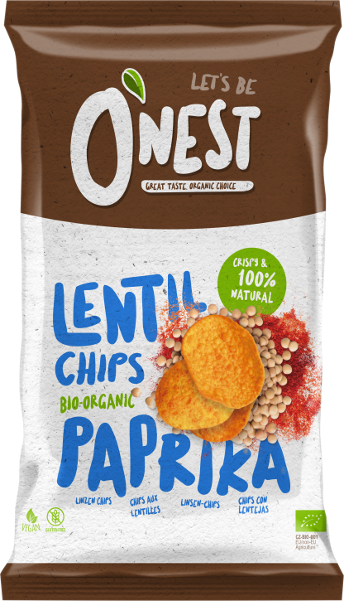
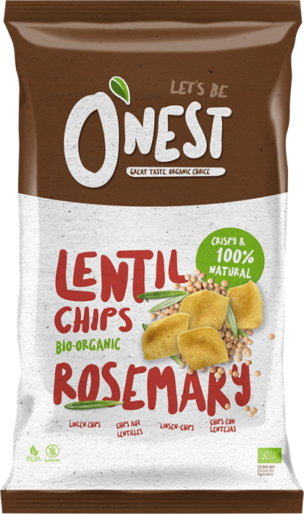

ON1223 O’nest chips
Lentilles paprika
10x75gr
ON915 O’nest chips
Lentilles romarijn
10x75gr
ON1177 O’nest chips
Lentilles paprika
12x40gr

